Slide 1
Safe Patient Handling at KGH
Musculoskeletal Injury (MSI) Prevention for Clinical Staff

Slide 2
Kingston General Hospital is committed to providing a safe and healthy work environment for you.
Musculoskeletal injuries (MSI) are the most common type of injuries that affect our healthcare workers. For this reason, KGH has set corporate targets to reduce the incidence of MSI that occur when mobilizing patients.
By providing assistive equipment and training on how to safely mobilize patients, we will help to create a safe work environment for our staff, learners and patients.

Slide 3
After completing this course you will be able to:
Recognize the MOVE ON Program:
Mobilization of Vulnerable Elderly in Ontario
Assess the weight bearing ability of a patient
Implement the Falling Star Program
Operate patient assistive equipment
Practice safe patient transfer methods

Slide 4
MOVE ON
To promote the early mobilization
and prevention of functional
decline in older patients admitted
to hospitals in Ontario, the MOVE
on program was rolled out across
the organization in clinical areas.

Slide 5
MOVE ON: Your Role and Responsibilities:
Assess the mobility level within the first 24 hours of a patient’s admission
Assess the patient’s mobility status every time you are moving a patient
Design a plan of care that includes patient mobility level
Inter-professional team collaboration
  Include patient and family
Facilitate change of patient’s position (supine to sitting) at least three times a day

Slide 6
MOVE ON: Outcomes
The primary outcome of MOVE ON is to increase the frequency of
mobilization of inpatients. Secondary outcomes include tracking…..
patient mobilization events at 48 and 72 hours after admission, and 24 hours before discharge
patient length of stay
patient’s functional status from admission to discharge
patient’s discharge destination
number of patient falls
number of staff injuries related to patient handling

Slide 7
Fall Risk Assessment
Mobilizing patients safely, reduces the risk of falls, decreases your risk of injury and decreases patient length of stay.
All patients (including ambulatory patients) are assessed for fall risk:
Within 24hrs of admission
Whenever there is a change in the patient’s condition
If the patient experiences a fall
At transition points (transfer between units)
While completing your mobility assessment you should also be completing a fall risk assessment which includes:
Patient history
Baseline functional assessment
History of falls
Change in mobility status

Slide 8
Fall Risk Assessment
If the patient falls…..
If the patient is falling…..
Follow the patient’s direction of movement safely to the ground. Do not attempt to ‘catch’ the patient.
Try to use good body mechanics: squat and lunge with your legs and avoid twisting your upper body.
If the patient is medically stable, make the patient comfortable. Get a pillow for their head and a blanket.
Get HELP – seek the help of other staff.
Use the appropriate equipment (ie. Floor lift, ceiling lift) to perform the lift safely.
Update the necessary documentation (incident report, Falling Stars Program).
How could the fall have been prevented?

Slide 9
Before you move a patient….PREPARE
PREPARE: PATIENT, ENVRIONMENT, CAREGIVER
PATIENT: Does the patient have appropriate footwear, hearing aids, eyeglasses, mobility aids (walker)?
ENVIRONMENT: Clear environment of any obstacles. Move bed, chair etc. as needed.
CAREGIVER: Adjust the height of the bed to roughly waist level to limit caregiver stooping or forward bending.

Slide 10
Assessing Weight Bearing Ability
Assessing the weight bearing ability of patients prior to mobilization is key in preventing injury to yourself, coworkers and patients.

Slide 11
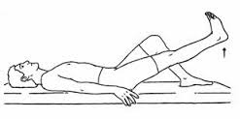
ASSESSMENT OF A PATIENT’S ABILITY TO WEIGHT BEAR:
1) Can the patient raise their leg against gravity?
This tests the patient’s ability to achieve hip flexion, which is needed to walk.
Notes:
Illustration adopted from Educational Material from the Saunder’s Group Inc.

Slide 12
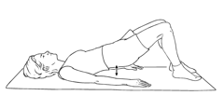
ASSESSMENT OF A PATIENT’S ABILITY TO WEIGHT BEAR:
2) Can the patient initiate and hold a pelvic bridge? Ask the patient to lift their bum(as if to place a bedpan underneath). Hold for 5 seconds.
This tests the patient’s glute strength to roll onto their side and eventually stand.

Slide 13
ASSESSMENT OF A PATIENT’S ABILITY TO WEIGHT BEAR:
3) Rolling patient onto side: MAXIMIZE USE OF PATIENT EQUIPMENT
a) Elevate height of bed to desired position to limit forward bending.
b) Elevate head of bed
c) Encourage use of side rail
d) Ask patient to shift bum and feet over to the edge of the bed. Assist as needed to sitting position.
Is the patient able to sit at bedside unsupported or with minimal support?
This indicates trunk strength, balance and control.

Slide 14
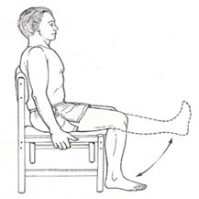
ASSESSMENT OF A PATIENT’S ABILITY TO WEIGHT BEAR:
4) Is the patient able to achieve knee extension while sitting?
Ask the patient to straighten their leg while seated at the bedside. This assesses the patient’s range of motion and quadriceps strength.

Slide 15
ASSESSMENT OF A PATIENT’S ABILITY TO WEIGHT BEAR:
5) Initial standing assessment of patient:
Is the patient able to stand?
Can the patient shift their weight from side to side?
Can the patient march on the spot?
In order to maintain your safety, ensure two staff are present during this assessment. If the patient is able to complete the above, proceed with the transfer. If not, assist patient back to bed, update and communicate new mobility status.

Slide 16
Communicating the Patient’s Mobility
You should assess the weight ability of a patient prior to every patient transfer
It is the responsibility of the RPN, RN and PT to update the patient logo. The PCA is to notify the RN of any change in the patient’s mobility level.
Once the mobility of the patient is determined, how the patient mobilizes needs to be communicated in two ways:
1) Above the patient bed with a logo (independent,
1 person assist, 2 person assist, ceiling lift).
2) Documented in the patient’s chart.

Slide 17
Mobility Algorithm: MOVE ON Program
In order to ensure your safety and the safety of other staff and
patients, the following Transfer Tree should be used to
determine patient mobility status by a registered patient care
provider.
Once the patient mobility status has been determined, a
mobility logo should be posted above the patient’s bed and
updated as needed by a registered patient care provider.

Slide 18
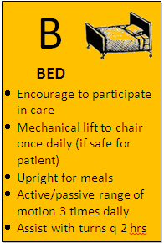
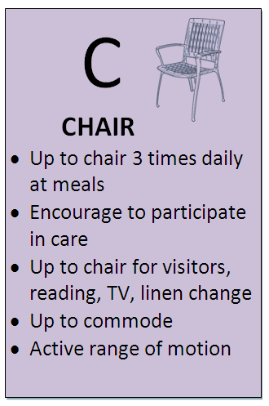
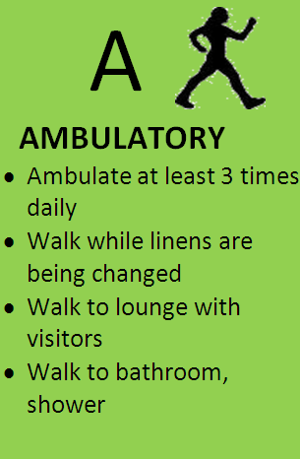
Mobility Level
B
Mobility Level
C
Mobility Level
A

Slide 19
PATIENT MOBILITY:
INDEPENDENT
The independent unsupervised transfer should
be used for patients assessed as totally
independent and safe with transfers.
RISK REDUCTION CHECKLIST:
Is the patient is wearing proper clothing including non-slip footwear ?
Is the path for the procedure clear?
Is the floor is dry and clear of tripping hazards?
Are the wheels on all equipment locked unless otherwise required?
Are the bed rails lowered if necessary?
Are the wheelchair arm and leg rests are removed if necessary

Slide 20
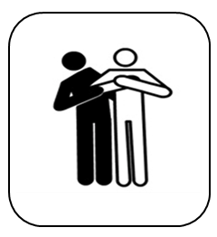
PATIENT MOBILITY:
ASSIST X 1
The assist x 1 procedure is used to
transfer a patient who requires
minimal physical assistance of one
caregiver to transfer or assistance
with equipment

Slide 21
PATIENT MOBILITY:
VIDEO: ASSIST X 1
To watch a video of an assist x 1 transfer click here:

Slide 22
PATIENT MOBILITY:
ASSIST X 2
The ASSIST X 2 may be
used with patients who have
moderate difficulty initiating the
standing position but do not need to
have their knees blocked as
required in a pivot transfer. They
may have some difficulty moving
their feet.
Assistive devices can be used to
facilitate the transfer.

Slide 23
How to Use a Sit to Stand Lift:
Sit-stand mechanical lifts (SARA) is used to lift or transfer a patient from seated position.
The SARA lift is used with patients who can….
  weight bear 40% on at least one leg.
  patients should follow some commands and participate.
  patients should have adequate trunk control.
DO NOT use the SARA lift with:
  total knee replacement (TKR)
  total hip replacements (THR)
  hip hemiarthroplasties.
Click here to see how to use a
Sit to Stand Lift

Slide 24
PATIENT MOBILITY:
Ceiling Lift
A total mechanical lift will be used to
transfer a patient from bed or chair
when a patient is:
not physically able to move himself and/or mentally able to help with lifts
not able to bear weight through at least one leg or using both arms and/or maintain balance while standing,
not able to move/straighten the hip, knee, shoulder or elbow due to severe contracture or pain or
inconsistent and aggressive.

Slide 25
How to Operate a Ceiling Lift:
Operating a ceiling lift involves a minimum of 2 caregivers.
Inspect the mechanical lift to ensure it is in good working condition (sling in good condition, carry bar strap not frayed or torn).
Ensure patient equipment is in place (ie. Chair, bed).
Reposition sling underneath patient so that the opening of the sling is at the coccyx of the patient.
Position the leg pieces and attach the loops of the sling to the carry bar.
Elevate the patient in the ceiling lift enough to clear the chair or bed surface.
Once the patient is lowered in the chair, hold the bar in place to prevent it swinging back and hitting the patient.
Unhook the sling loops from the carry bar while holding the bar in place, move the bar away, and return the lift to the Home Position.

Slide 26
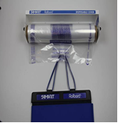
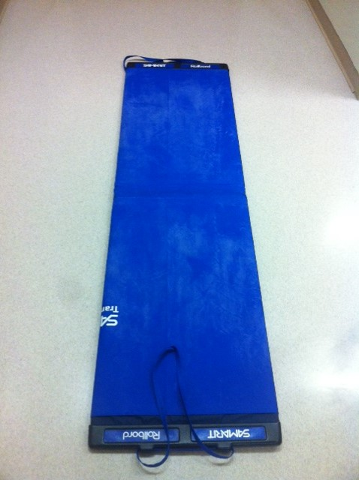
Patient Transfer Boards
2 Types at KGH:
1) Soft Folding Board
Day to day cleaning requires Oxivir wipes (0.5% hydrogen peroxide)
For Contact Precautions/Isolation patients, a disposable sleeve is required over the board

Slide 27
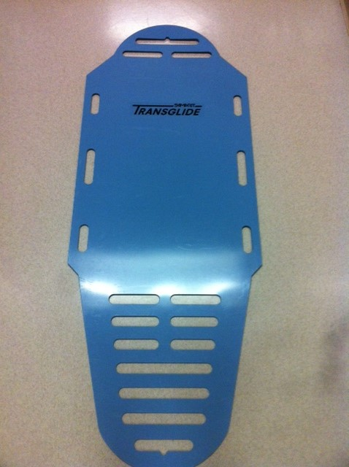
Patient Transfer Boards
2 Types at KGH:
2) Rigid Board
Day to day cleaning requires Oxivir wipes (0.5% hydrogen peroxide)
For Contact Precautions/Isolation patients, Sporicidal (4.5% hydrogen peroxide). No sleeve is required.

Slide 28
Transfer Board
WHEN TO USE
The transfer board is to be used to transfer patients from one surface to another surface of equal height.
The board can be used for patients with excessive weakness in the lower limbs and trunk, knee and/or hip contracture and/or leg amputees or patients with sternal precautions.

Slide 29
How to Use a Transfer Board
Explain the procedure to the patient
Raise bed (or patient surface) between mid thigh and hip height
Roll the patient on their side and place the board on the bed, aligned with the patient’s spine. Place a draw sheet on top of the transfer board, again aligned with the patient’s spine.
Roll the patient back to the supine position; they are now on one half of the board.
Raise the receiving surface to the level of the bed and lock the brakes.
Care giver on one side places open palms on the patient’s hip and shoulder. The receiving care giver is on the opposite side of the stretcher

Slide 30

Creating a Safe Work Environment
If you have any concerns or questions regarding how we can help to create a safe working environment for you, staff and patients at KGH, please contact:
Occupational Health and Safety at x 4389.

