Slide 1
Preventing
Musculoskeletal Injuries at KGH

Slide 2
Kingston General Hospital is committed to providing a safe and healthy work environment for you and your coworkers.
Did you know that Musculoskeletal injuries (MSI) are the most common type of injury that affect KGH staff? For this reason, KGH has made MSI prevention a key area of focus.
Knowing and following safe work practices that consider ergonomic principles will help to create an environment that will be safe for our staff and our patients.

Slide 3
Learning Objectives
After completing this course you will have an understanding of:
  Musculoskeletal injuries (MSIs)
  Ergonomic risk factors which contribute to the development of a MSI
  Common symptoms of a MSI
  How to prevent MSIs including how to:
Push, pull and lift materials and equipment safely
Set up your workspace appropriately
Use appropriate body mechanics

Slide 4
What is Ergonomics?
Ergonomics is about designing work for ‘best fit’ to people.
Ergonomics is the interaction of humans with their environment and the tools they use. When ergonomics is considered in work design, people can work safely and efficiently

Slide 5
What is a MSI?
Musculoskeletal Injuries or MSIs are injuries and disorders that affect the human body’s movement or musculoskeletal system (i.e. muscles, tendons, ligaments, nerves, discs, blood vessels, etc.).
Some symptoms of an MSI may include:
Swelling, redness, pain, numbness and tingling, reduced range of motion, weakness of the affected area.
MSIs may result due to excessive force, frequency and/or awkward postures.

Slide 6
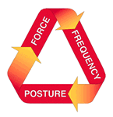
Key Risk Factors for Developing a MSI
Force, frequency and awkward postures can contribute to the development of a MSI.
The risk of injury increases when any of these risk factors are combined. The length of time or duration of these risk factors also increases the risk of injury.
Duration

Slide 7
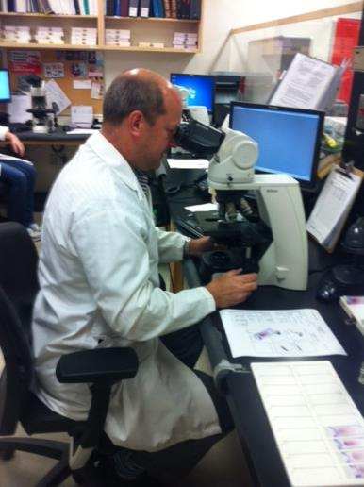
Frequency
Repeatedly performing tasks that use the same muscle groups or motion around a joint can cause strain to your musculoskeletal system.
The risk of injury is higher when these highly repetitive tasks also require awkward postures and/or when you perform them for long periods of time.

Slide 8
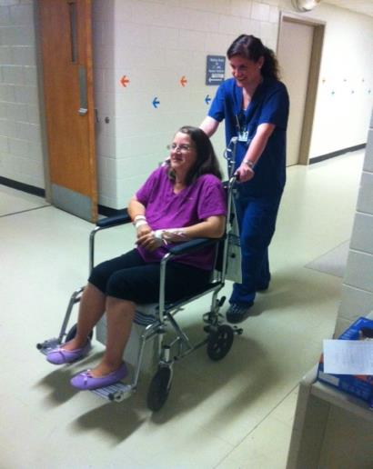
Force
Force is the amount of effort required by the body to perform a task such as lifting, pushing, pulling, carrying, gripping etc.
An injury can occur if the amount of force exceeds your body’s capability, or when the force is used repeatedly without giving your muscles sufficient time to rest and recover.
The harder your muscles work, the more time is needed for those muscles to recover or injury may occur.
Heavy load + twisting your back = ↑risk of injury

Slide 9

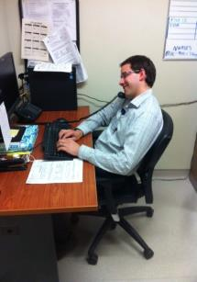
Awkward Postures
Awkward postures place excessive force on joints and overload the muscles and tendons around the affected joint
The risk of injury increases when joints work outside of their mid-range repetitively or for sustained periods of time without adequate recovery time.

Slide 10
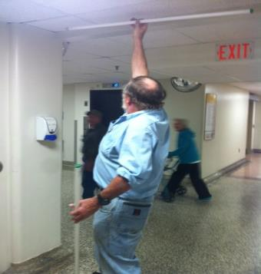
What is a Static Awkward Posture?
Postures that are held or
maintained for an extended
period of time to perform a
particular task
When static postures are held,
muscles are at greater risk of
injury due to limited blood and
oxygen flow. The muscles
become fatigued as a result of
constantly contracting to hold
the position.

Slide 11
Back Posture and Pressure on the Spine
E
C
D
B
185%
140%
150%
100%
A
25%
As we move from a neutral standing posture, the load on the spine increases.
Maintaining a neutral back posture helps to minimize back injury, whether job tasks involve mostly sitting, standing, or walking.
Notes:
The Lumbar Spine

Slide 12
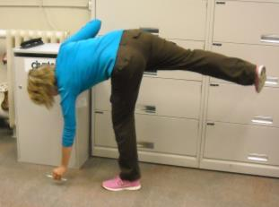
Golfer’s Lift for Lighter Loads
Face the object you are going to lift, and put all of your body weight on one leg.
Place the opposite hand on a support (chair, desk, knee, etc.), and bend straight over from the hip. The weighted knee can bend slightly, too.
Maintain your neck and back in a straight line to offset the strain on the back.
While you bend, allow the leg with no weight on it to lift off of the ground.
This leg counterbalances the weight of the upper body, and reduces the strain on the back.

Slide 13
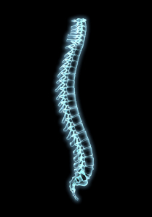
Neutral Posture of the Spine
When standing upright, the spine is in neutral position: the lower back curve (circled) is maintained, and this is VERY important
WHY?
The lower back curve allows pressure to be evenly distributed through the spine
When we sit, we lose this lower back curve. For prolonged sitting its is important that your chair supports the natural curve of your back.

Slide 14
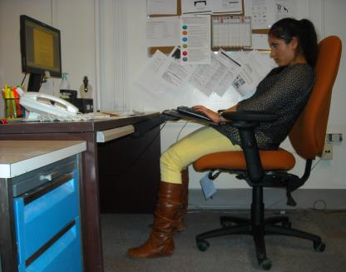
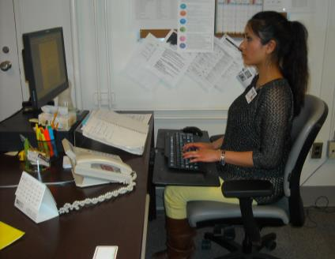
Correcting Your Workstation Setup
.
Notes:
Monitor height:
Neck: balanced over shoulders, not leaning forward or leaning back
Elbows are not resting on armrests while typing: shoulders are relaxed, and arms line up with the side-seam of shirt
Wrists are straight and not resting on wristrest while typing
Keyboard is adjusted so it’s straight and not angled. This will allow the wrists to remain in a neutral posture.
Lower back is aligned with the lumbar support of the chair; worker is sitting in most supportive position for her back
Thighs are supported and feet are flat on the ground; this means that pressure is alleviated off the lower back in a sitting position.
Other: frequently used items are placed within arms reach of worker (phone, notebook)
Other: notebook and papers used in conjunction with computer have been raised on document holder to avoid “bobbing” motion of neck.

Slide 15
What is Manual Materials Handling?
Any handling or moving tasks involving the human body as the main source of power and effort including:
Lifting/lowering
Pushing/Pulling
Carrying/holding/gripping

Slide 16
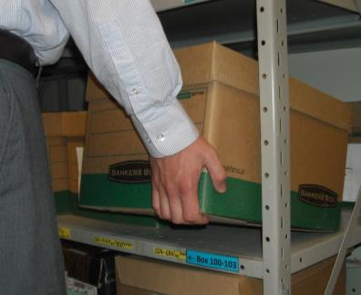
Safe Practices for Lifting
1) Test the Load
Before lifting, size up the load to determine whether its light enough to safely lift independently. For example, lift up a corner of the box to test how heavy it is before lifting the whole box.
Do not lift items that are slippery, too hot, or unevenly balanced.

Slide 17

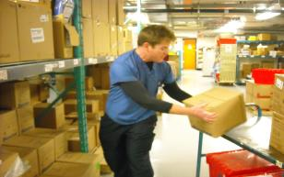
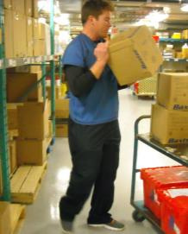
Safe Practices for Lifting
2) Face the direction of the load
Avoid twisting at the hips and spine to transfer material.
Instead, pivot with feet and face the load.

Slide 18
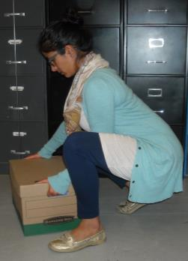
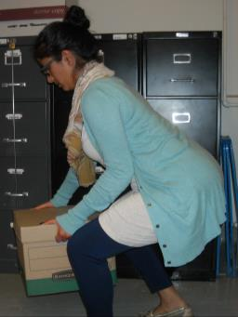
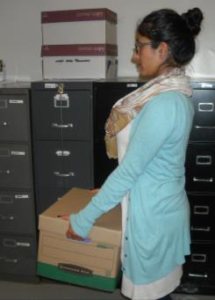
Safe Practices for Lifting
3) Stick out your buttocks!
Use the strong muscles of your legs - squat and semi-squat

Slide 19
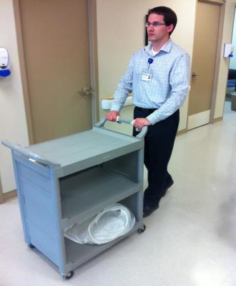
Safe Practices for Pushing/Pulling
Push whenever possible – this allows you to use both hands and the strong muscles of your legs
When pushing, handles should be between waist and shoulder height and arms should be kept close to the body

Slide 20

If YOU have an MSI or Ergonomic concern…….
Talk to your supervisor or manager about your concern. Health and Safety legislation requires workers to report safety hazards to their supervisors.
If an assessment is required, you and/or your manager can contact the Ergonomist at Occupational Health and Safety at x 6784.

Slide 21
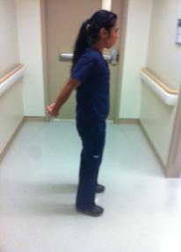
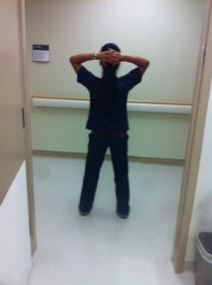
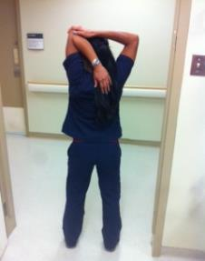
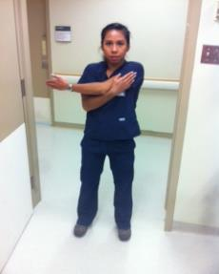
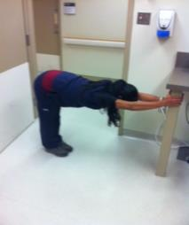
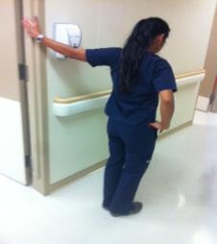
Stand up and S T R E T CH!

